Slide 1


Aplikasi Proses Bisnis II (SAP)
Pengantar
Introduction of SAP
SD
FI
MM
CO
PP
AM
SAP R/3
Client/Server
ABAP
Basis
QM
PS
PM
WF
HR
IS
Oleh :
Ahmad Sugiyarta, ST., M.Kom

Slide 2
Introduction to SAP
SAP University Alliances
Version 2.1
Author Stefan Weidner
Product
SAP ERP 6.0 EhP4
Level
Beginner
Focus
Cross-functional integration
SD, MM, PP, FI, CO,
HCM, WM, PS
Abstract
This teaching material is intended to explain how the fundamental business processes interact with SAP ERP in functional areas such as Sales and Distribution, Materials Management, Production Planning, Financial Accounting, Controlling, and Human Capital Management.

Slide 3
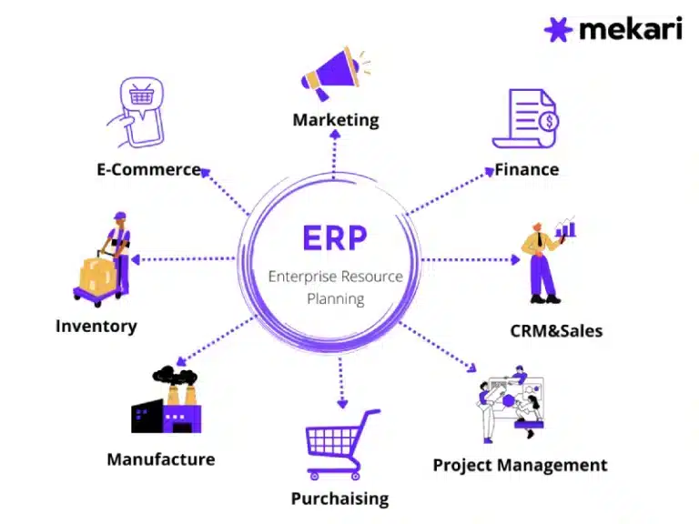
ERP Overview

Slide 4
ERP Overview
Enterprises Resource Planning (ERP) adalah suatu sistem terkait pengaturan data bisnis atau usaha yang banyak dipakai oleh perusahaan besar maupun kecil. Sistem ERP mampu mengumpulkan dan mengatur informasi bisnis utama dan membantu perusahaan menjalankan operasi yang efektif dan efisien.
Enterprise Resource Planning atau ERP merupakan proses pengumpulan dan pengorganisasian data bisnis melalui rangkaian software yang terintegrasi. Pada dasarnya, ERP adalah aplikasi yang mengotomatisasi proses bisnis, mengontrol, dan mengumpulkan masukan dari berbagai data.

Slide 5
ERP Overview
Data tersebut meliputi data akuntansi, manufaktur, rantai pasokan, penjualan, pemasaran dan sumber daya manusia (SDM). Setelah informasi dikompilasi dalam database pusat, para atasan sebuah perusahaan dapat mengetahui bagaimana cara untuk memberdayakan mereka.
Awalnya, ERP diterapkan pada manufaktur, dengan model Economic Order Quantity (EOQ). Sistem penjadwalan yang digunakan masih berbasis kertas. Lambat laun, sistem tersebut digantikan oleh sistem Material Resource Planning (MRP). MRP mulai dikembangkan pada tahun 1960-an yang akhirnya menjadi MRP II. ERP modern mulai dipakai di perusahaan pada tahun 1990-an sebagai software yang terintegrasi dengan operasi bisnis sehari-hari.

Slide 6
Bagaimana Cara Kerja ERP
Cara kerja sistem ERP melibatkan pengumpulan data dari berbagai departemen dan fungsi dalam organisasi dan disimpan dalam satu database terpusat.
Data diintegrasikan dan dianalisis untuk mengoptimalkan proses bisnis, mengotomatisasi tugas-tugas, meningkatkan kolaborasi tim, serta memberikan pengawasan dan kontrol yang lebih baik.
Dengan demikian, sistem ERP membantu organisasi meningkatkan efisiensi, produktivitas, dan visibilitas dalam operasi bisnis mereka.
Sistem ERP merupakan alat digital baru yang memungkinkan perusahaan untuk mengelola hubungan rantai pasokan mengontrol inventaris, otomatisasi akuntansi, dan lain-lain.

Slide 7
Jenis-Jenis ERP
ERP On Premise
Software ERP yang digunakan secara langsung dalam perangkat di perusahaan. Sistem ini dirancang untuk semua ukuran perusahaan, meskipun mungkin lebih sesuai untuk perusahaan kecil dan menengah
Open Source ERP
Jenis ERP ini memungkinkan perusahaan untuk memeriksa, memodifikasi, dan meningkatkan kode sumber ERP
ERP Berbasis Cloud
Jenis ERP ini tersedia melalui layanan hosting Cloud. Opsi ini memungkinkan perusahaan untuk mengakses data secara real-time selama perusahaan memiliki akses internet. Software ERP berbasis cloud umumnya cocok digunakan dalam perusahaan besar.
Hybrid ERP
ERP ini merupakan sistem perencanaan sumber daya perusahaan yang memadukan penyebaran on-premise dan berbasis Cloud

Slide 8
Modul-Modul ERP
Asset Managament (Manajemen aset)
Financial Accounting (Fico atau keuangan)
Human Resources (SDM)
Industry-Spesific Solutions
Plant Maintenance
Production Planning (Perencanaan produksi)
Quality Management (Manajemen mutu)
Sales and Distribution (Penjualan dan distribusi)
Inventory Management (Manajemen persediaan)

Slide 9
Course Overview
Introduction to SAP
Navigation
Introduction to GBI
Sales & Distribution
Materials Management
Production Planning
Financial Accounting
Controlling
Human Capital Management
Warehouse Management
Project System

Slide 10
SAP
“Systeme, Anwendungen und Produkte in der Datenverarbeitung”
(English: “Systems, Applications, and Products in Data Processing”)
“SAP Stands for Systems, Applications and Products in Data Processing”
Global concern with many companies
SAP AG
SAP America
SAP UK etc.
SAP Business Suite
SAP Enterprise Resource Planning (SAP ERP)
SAP Supplier Relationship Management (SAP SRM)
SAP Customer Relationship Planning (SAP CRM)
SAP Supply Chain Management (SAP SCM)
SAP Product Lifecycle Management (SAP PLM) etc.
SAP Business ByDesign
SAP NetWeaver

Slide 11
Who is SAP?
SAP AG
Founded in Walldorf, Germany in 1972
World’s Largest Business Software Company
World’s Third-largest Independent Software Provider
SAP Statistics
SAP is an industry-leading software application company, head- quarters in Waldorf, Germany, providing Enterprise Resource Planning for large and multi-national companies
3rd Largest Software Vendor in the World
Source: SAP AG website
Notes:
SAP is the world's largest inter-enterprise software company and the world's third-largest independent software provider overall. We have a rich history of innovation and growth that has made us a true industry leader.
SAP Americas
12 Million Users. 100,600 Installations. 1,500 Partners.
SAP Americas is a subsidiary of SAP AG, the world's largest inter-enterprise software company and the third-largest software supplier overall. SAP Americas's corporate headquarters is located in Newtown Square, PA, a suburb of Philadelphia. Our officers and executives lead a team of professionals dedicated to delivering high-level customer support and services.
Founded in 1972 as Systems Applications and Products in Data Processing, SAP has a rich history of innovation and growth that has made us the recognized leader in providing collaborative business solutions for all types of industries -- in every major market. The company, headquartered in Walldorf, Germany, employs more than 37,700 people in more than 50 countries, and serves more than 34,600 customers worldwide.
Experience, Knowledge, and Technology for Maximizing Business
SAP has leveraged our extensive experience to deliver mySAP Business Suite, the definitive family of business solutions for today's economy. These solutions are open and flexible, supporting databases, applications, operating systems, and hardware from almost every major vendor. What's more, mySAP Business Suite allows employees, customers, and business partners to work together successfully -- anywhere, anytime.
By deploying the best technology, services, and development resources, SAP has delivered a business platform that unlocks valuable information resources, improves supply chain efficiencies, and builds strong customer relationships. And through the Global Solution Center, SAP Americas identifies customer needs and develops solutions to meet these needs.
SAP is listed on several exchanges, including the Frankfurt Stock Exchange and the New York Stock Exchange, under the symbol "SAP."

Slide 12
Who is SAP?
SAP AG
Founded in Walldorf, Germany in 1972
World’s Largest Business Software Company
World’s Third-largest Independent Software Provider
Company Statistics
SAP is an industry-leading software application company, head- quarters in Waldorf, Germany, providing Enterprise Resource Planning for large and multi-national companies
3rd Largest Software Vendor in the World
Over 45,000 employees in more then 50 countries
1,500+ Business Partners
95,000+ customers in more then 120 countries
12 million users
100,000+ installations
Source: SAP AG website
Notes:
SAP is the world's largest inter-enterprise software company and the world's third-largest independent software provider overall. We have a rich history of innovation and growth that has made us a true industry leader.
SAP Americas
12 Million Users. 100,600 Installations. 1,500 Partners.
SAP Americas is a subsidiary of SAP AG, the world's largest inter-enterprise software company and the third-largest software supplier overall. SAP Americas's corporate headquarters is located in Newtown Square, PA, a suburb of Philadelphia. Our officers and executives lead a team of professionals dedicated to delivering high-level customer support and services.
Founded in 1972 as Systems Applications and Products in Data Processing, SAP has a rich history of innovation and growth that has made us the recognized leader in providing collaborative business solutions for all types of industries -- in every major market. The company, headquartered in Walldorf, Germany, employs more than 37,700 people in more than 50 countries, and serves more than 34,600 customers worldwide.
Experience, Knowledge, and Technology for Maximizing Business
SAP has leveraged our extensive experience to deliver mySAP Business Suite, the definitive family of business solutions for today's economy. These solutions are open and flexible, supporting databases, applications, operating systems, and hardware from almost every major vendor. What's more, mySAP Business Suite allows employees, customers, and business partners to work together successfully -- anywhere, anytime.
By deploying the best technology, services, and development resources, SAP has delivered a business platform that unlocks valuable information resources, improves supply chain efficiencies, and builds strong customer relationships. And through the Global Solution Center, SAP Americas identifies customer needs and develops solutions to meet these needs.
SAP is listed on several exchanges, including the Frankfurt Stock Exchange and the New York Stock Exchange, under the symbol "SAP."

Slide 13
Integrated Business Solution Vendors
SAP
SAP Business Suite, SAP All-in-One, SAP Business ByDesign, SAP Business One
Oracle Applications
Oracle, JD Edwards, PeopleSoft, Siebel, Retek
Microsoft Business Solutions
Dynamics: Great Plains, Navision, Axapta, Soloman
The Sage Group
Sage Software – Accpac ERP, PeachTree
SSA Global Technologies
BAAN

Slide 14
SAP Portfolio Strength
World-wide usage
Designed to satisfy the information needs for all business sizes (small local to large all international)
Multi-lingual
Multi-currency
Multi-balance (parallel G/L Accounting)
Designed to satisfy the information needs for all industries, e.g.
Automotive
Banking
Retail
Public Sector
Higher Education and Research etc.

Slide 15
SAP Enterprise Resource Planning (SAP ERP)
Enables a company to support and optimize its business processes
Ties together disparate business functions (integrated business solution) such as
Finance (Financial Accounting, Managerial Accounting, Treasury, …)
Logistics (Sales, Procurement, Production, Fulfillment, …)
Human Resources etc.
Helps the organization run smoothly
Real-time environment
Scalable and flexible

Slide 16
SAP Architecture
Client/Server Environment
Client – hardware/software environment that can make a request for services for a central repository of resources
Server – hardware/software combination that can provide services to a group of clients in a controlled environment
Three – Tier Structure
GUI
Graphical User Interface or Web Interface
Application Server
One or more, help distribute work load
Database Server
One single data repository

Slide 17
SAP Business Suite
SAP NetWeaver
SAP PLM
SAP ERP
SAP
SRM
SAP CRM
SAP SCM

Slide 18
History
SD
FI
SAP NetWeaver
MM
SAP PLM
CO
PP
AM
SAP ERP
SAP R/3
Client/Server
ABAP
Basis
SAP
SRM
SAP CRM
QM
PS
PM
WF
SAP SCM
HR
IS

Slide 19
SAP Software Applications
Solutions
SAP ERP
SAP CRM
SAP PLM
SAP SCM
SAP SRM
SAP Business Objects
Small & Medium Size Solutions
SAP All-in-One
Business ByDesign
Business One
Platforms
SAP NetWeaver
SAP Enterprise Services Architecture

Slide 20
SAP ERP Business Modules
Collections of logically related transactions within identifiable business functions
MM (“Buy”)
PP (“Make”)
SD (“Sell”)
FI and CO (“Track”)
HCM (“People”)
WM (“Store”)
EAM (“Maintain”)
CS (“Service”)

Slide 21
SAP ERP Core Applications
Logistics
Sales & Distribution
Materials Management
Production Planning
Plant Maintenance
Quality Management
Finance
Financial Accounting
Managerial Accounting
Asset Management
Treasury
Human Capital Management
Personnel Management
Benefits
Payroll

Slide 22
SAP Industry Solutions
Aerospace & Defense
Automotive
Banking
Chemicals
Consumer Products
Defense & Security
Engineering, Const.
Healthcare
High Tech
Higher Education
Industrial Machinery
Insurance
Life Sciences
Logistics Service Prod.
Media
Mill Products
Mining
Oil & Gas
Pharmaceuticals
Postal Services
Professional Services
Public Sector
Railways
Retail
Telecommunications
Utilities
Wholesale Distribution

Slide 23
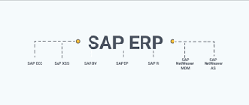
Perbedaan ERP dan ECC
ECC merupakan solusi ERP yang disediakan oleh SAP . ECC merupakan singkatan dari ERP Central Component dan ECC merupakan istilah yang hanya berlaku untuk SAP. ECC merupakan komponen dari paket perangkat lunak ERP SAP. Rangkaian ERP menyediakan manajemen dan kontrol fungsi secara keseluruhan.

Slide 24
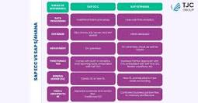
Perbedaan ECC dan S4 HANA
SAP ECC dilengkapi dengan SAP GUI sementara S/4HANA dilengkapi dengan SAP Fiori 3.0 yang tertanam , yang membuat pengalaman pengguna lebih menarik dan lancar. SAP S/4HANA memproses data menggunakan analitik real-time sementara SAP ECC mengikuti metode pemrosesan batch tradisional.

Slide 25
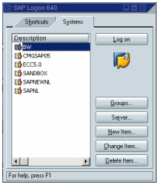
SAP Navigation Tips
SAP GUI
Graphical User Interface. The SAPgui is the software on your computer or local server that allows you to connect to one or more of the SAP environments.

Slide 26
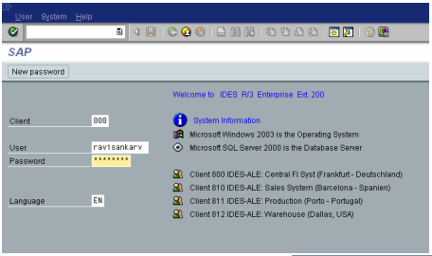
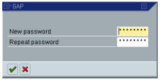
SAP Navigation Tips
SAP Initial Screen

Slide 27
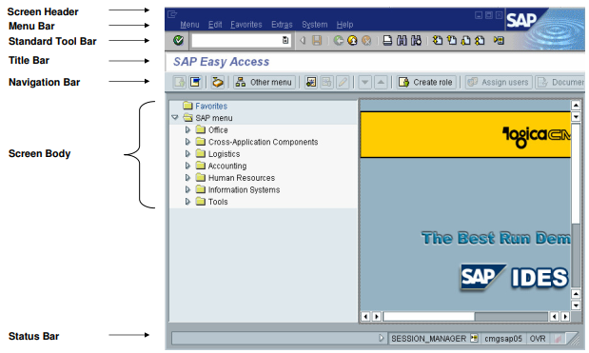
SAP Navigation Tips
SAP Initial Screen

Slide 28
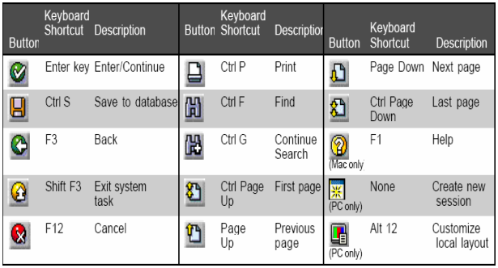
SAP Navigation Tips
SAP Standard Toolbar Buttons

Slide 29
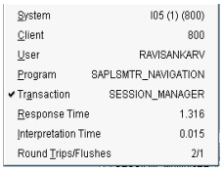
SAP Navigation Tips
Important Details to be Noted
• System • Client • User • Program • Transaction • Response Time • Interpretation Time • Round Trips / Flushes

Slide 30
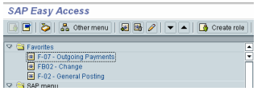
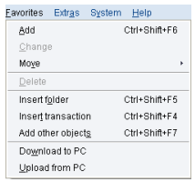
SAP Navigation Tips
Favorites
Favorites Menu

Slide 31
CALLING FUNCTION - SAP
/n to cancel the current transaction
/n#### to call transaction #### directly from another transaction
Without the prefix you can only call #### from the SAP Easy Access Screen
/o to display an overview of sessions
/o#### to call transaction #### in a new session directly from another transaction
/nend to end the logon session with a confirmation dialog box
nex to end the logon session without a confirmation dialog box
/i to delete the session you are currently using

Slide 32
SAP T-Code
T-Code SAP
• MM01 – CREATE MATERIAL MASTER • MM02 – CHANGE MATERIAL MASTER • MM03 – DISPLAY MATERIAL MASTER • MD04 – STOCK REQUIREMENT • MMBE – STOCK OVERVIEW • MB51 – MATERIAL DOCUMENT • MB22 – CHANGE RESERVATION • ME23 – DISPLAY PO (PURCHASE ORDER)

Slide 33
Aplikasi Proses Bisnis II (SAP)
Pertemuan 3
Maintain Material Master
SD
FI
MM
CO
PP
AM
SAP R/3
Client/Server
ABAP
Basis
QM
PS
PM
WF
HR
IS
Oleh :
Ahmad Sugiyarta, ST., M.Kom

Slide 34
SAP Maintain Material Master
SAP University Alliances
Version 2.1
Author Stefan Weidner
Product
SAP ERP 6.0 EhP4
Level
Beginner
Focus
Cross-functional integration
SD, MM, PP, FI, CO,
HCM, WM, PS
Abstract
This teaching material is intended to explain how the fundamental business processes interact with SAP ERP in functional areas such as Sales and Distribution, Materials Management, Production Planning, Financial Accounting, Controlling, and Human Capital Management.

Slide 35
Course Overview
Introduction to SAP
Navigation
Introduction to GBI
Sales & Distribution
Materials Management
Production Planning
Financial Accounting
Controlling
Human Capital Management
Warehouse Management
Project System

Slide 36
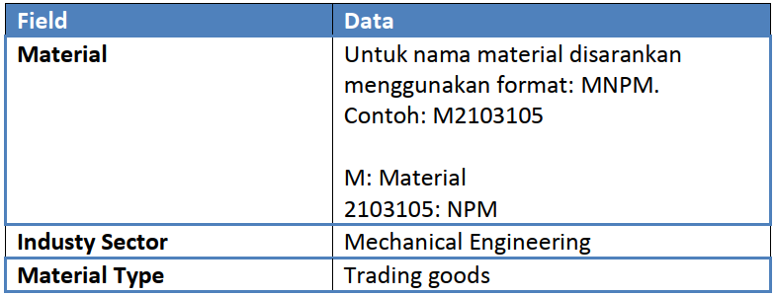
SAP
Dalam membuat material master record baru diperlukan untuk mendefinisikan
nama material (harus unik), industry sector, material type, views, dan plant
information yang relevan untuk tipe material master record yang akan dibuat.
1. Transaksi untuk membuat material master record baru adalah :
Logistics → Material Master → Material → Create (general) → immediately (MM01)
2. Buat material baru dengan deskripsi sebagai berikut, lalu enter :

Slide 37
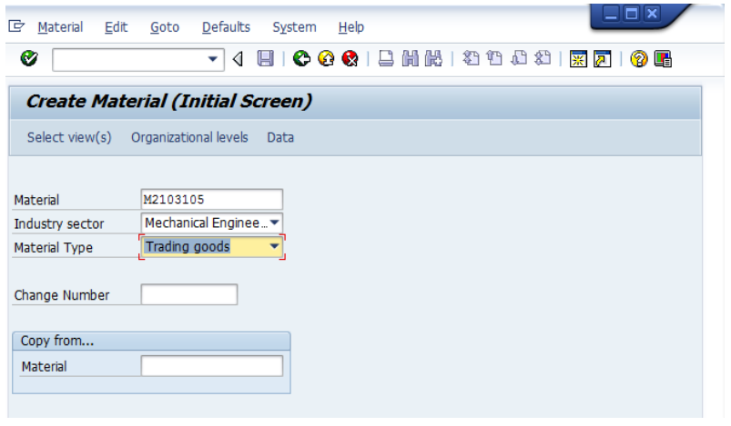
SAP
3. Pilih view sesuai kebutuhan data yang akan di-entry seperti pada gambar dan tabel berikut, lalu enter:

Slide 38
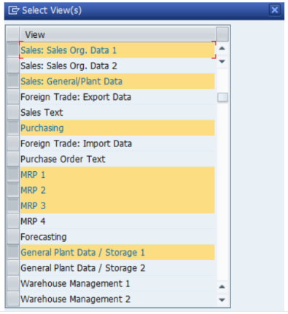
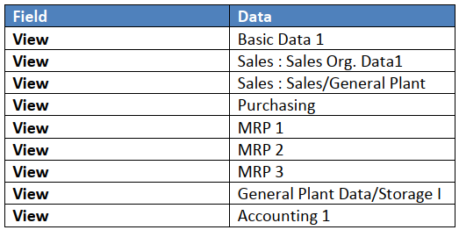
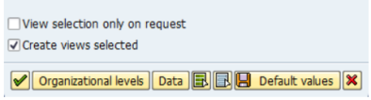
SAP
Pilih view-view berikut :

Slide 39
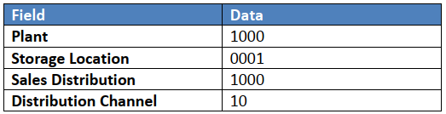
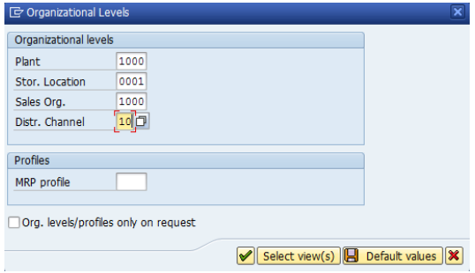
SAP
4. Lalu pilih organizational level sesuai dengan gambar dan tabel berikut, lalu enter:

Slide 40
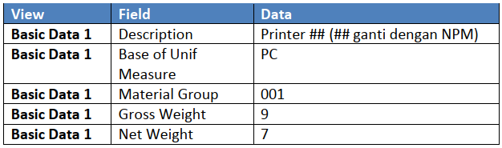
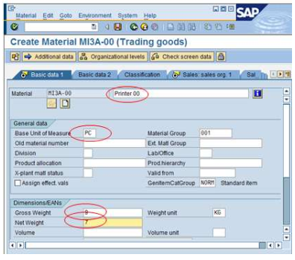
SAP – CREATE MATERIAL MASTER
5. Lakukan entry data sesuai dengan view basic data 1 seperti pada gambar dan tabel berikut, lalu enter (jangan di-save):

